Slide 1
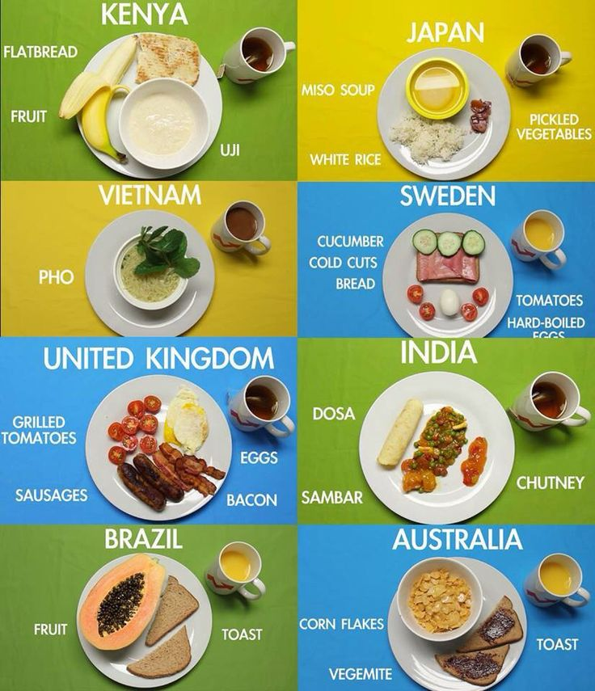
Traditional food of different countries.

Slide 2
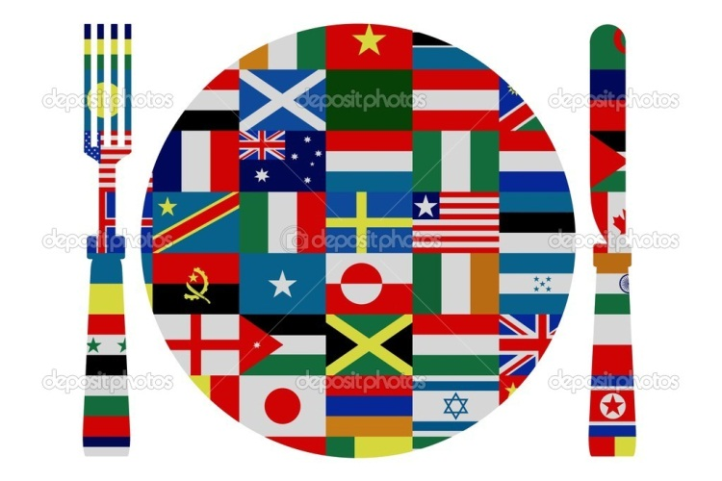
Fish and chips is English
Sushi’s Japanese.
Pizza is Italian,
So is mozzarella cheese!
In Spain they eat paella,
In China they eat rice.
The Russians think potatoes
Are really, really nice!

Slide 3
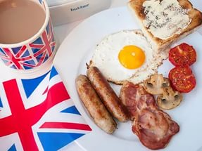
English food
-Roast beef and Yorkshire pudding.
-Spotted dick (suet pudding with currants and raisins).
-English cream tea, particularly in south coast seaside resorts (scones, jam, butter, clotted or double cream and, of course, tea).
-Regional varieties of baking such as Bakewell pudding (pastry base covered with jam, almond filling and topped with icing), and breads of all description.
-English cheeses such as Cheddar, Wensleydale, Lancashire and Stilton.
-Fish and chips (battered and deep fried).

Slide 4
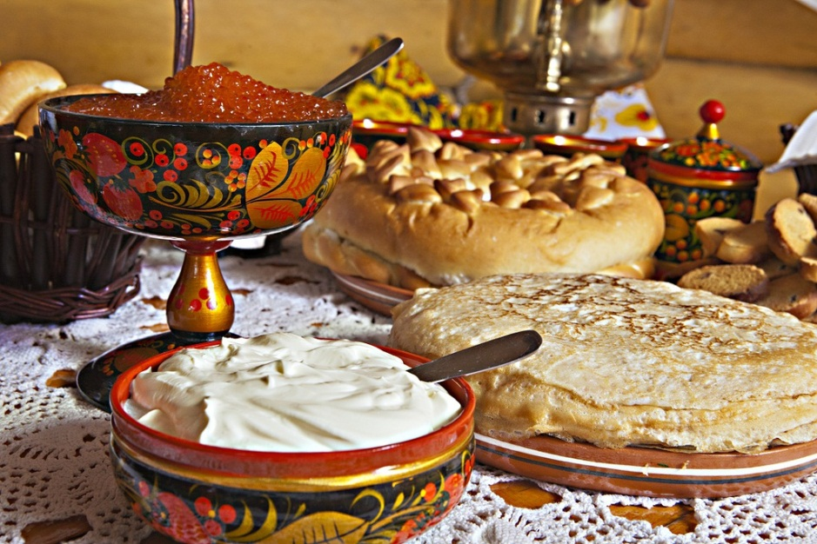
RUSSIAN FOOD
Borsch is a beet soup.
Pirozhki - little pastries can be packed full of potatoes, meat, cabbage, or cheese.
Blini are also served rolled with a variety of fillings: jam, cheese, onions, or even chocolate syrup.
Pelmeni are pastry dumplings filled typically with meatballs.

Slide 5
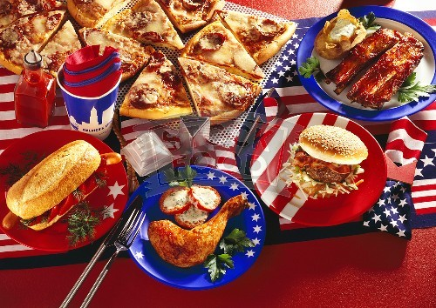
AMERICAN FOOD
-Hamburgers.
- Fried chicken.
-Barbecue.
- Cheesecake.
- Key lime pie.
- Apple pie.

Slide 6
